Slide 1
Tree Safety Analysis
TreeCalc
Is your tree safe?
for: Instytut Drzewa
Tree Assessment Congress
Wroclaw
28.02.2019 - 01.03.2019

Slide 2
Speaker Profile
Landscape Gardener
Landscape Technician
Court Certified Expert Witness
MSc, Urban Forestry
Erk Brudi - TreeConsult since 1993
Notes:
Good afternoon. Before I introduce you to my topic today. I would like to give you some background information about myself and my company.
40 years ago I started my career as an apprentice in landscaping
After that I gathered working experience in Germany the US and Australia and went to school again.

Slide 3
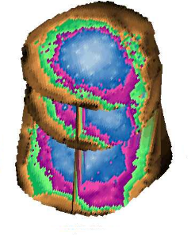
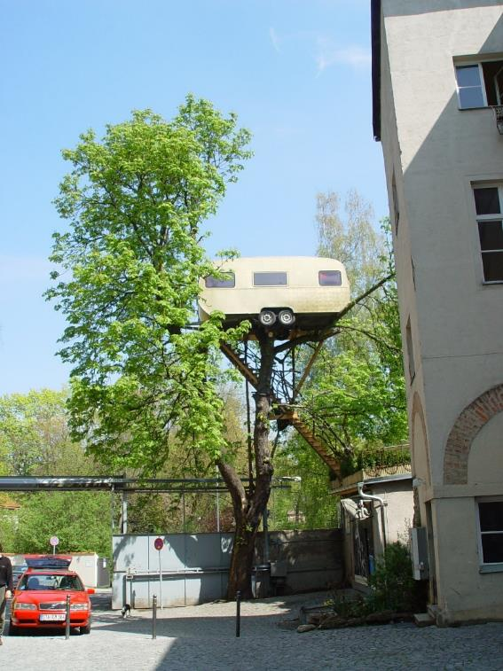
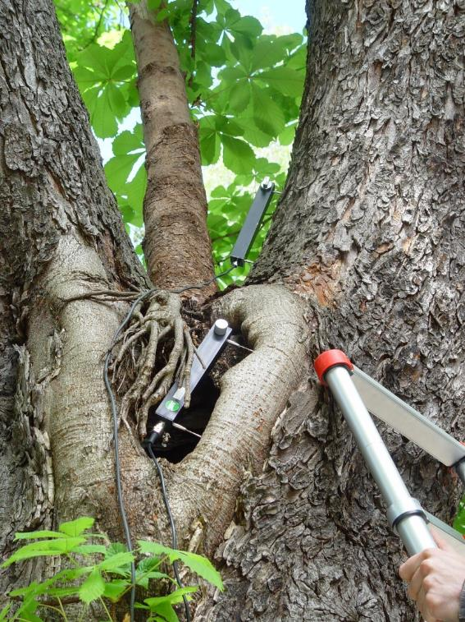
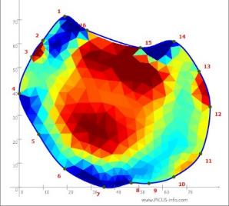
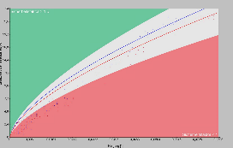
Company Profile
Measuring and Evaluation of Tree Safety

Slide 4
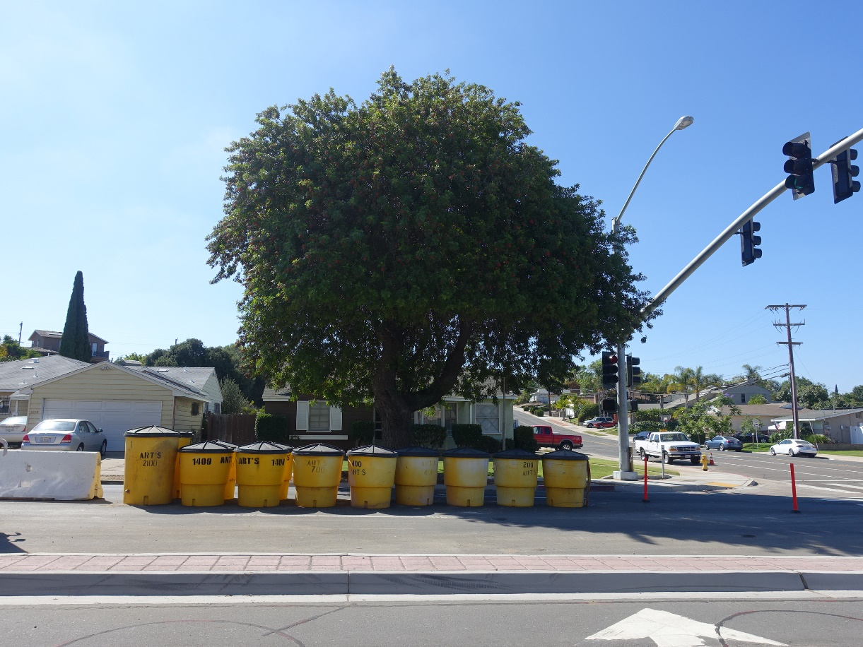
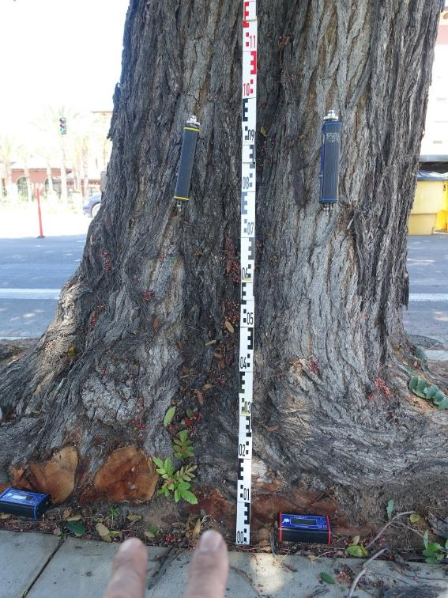
Company Profile
Measuring and Evaluation of Tree Safety

Slide 5
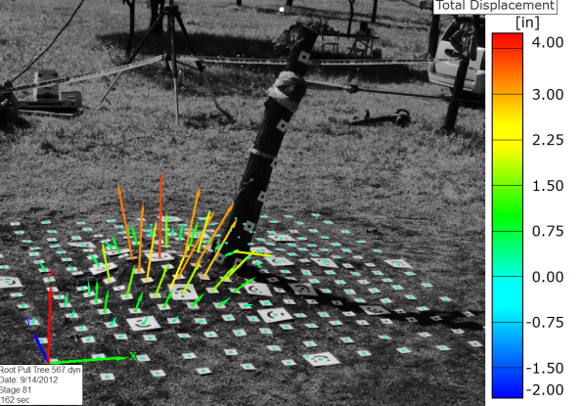
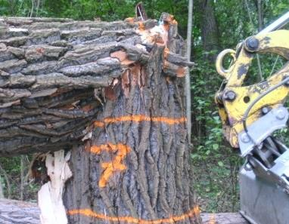
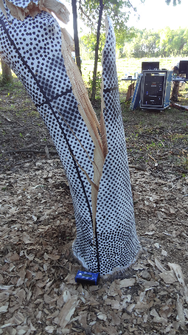
Company Profile
Tree Mechanics Research

Slide 6
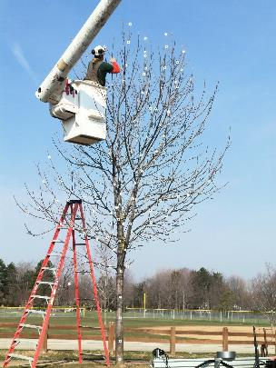
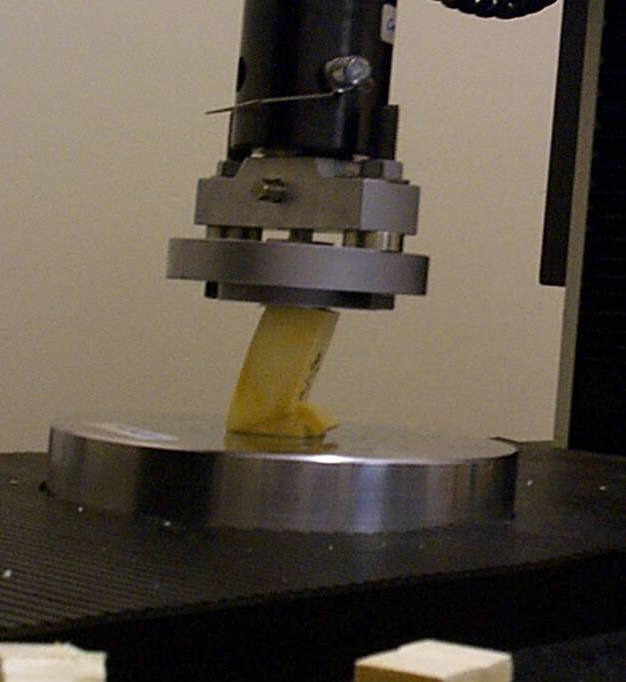
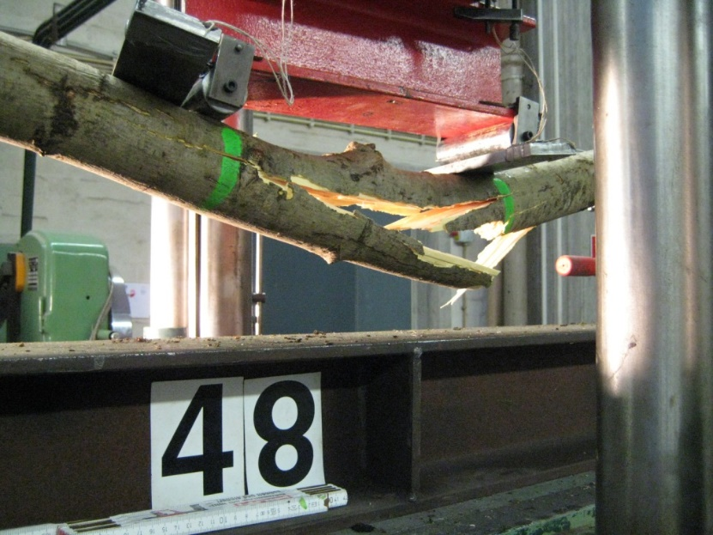
Company Profile
Tree Mechanics Research

Slide 7
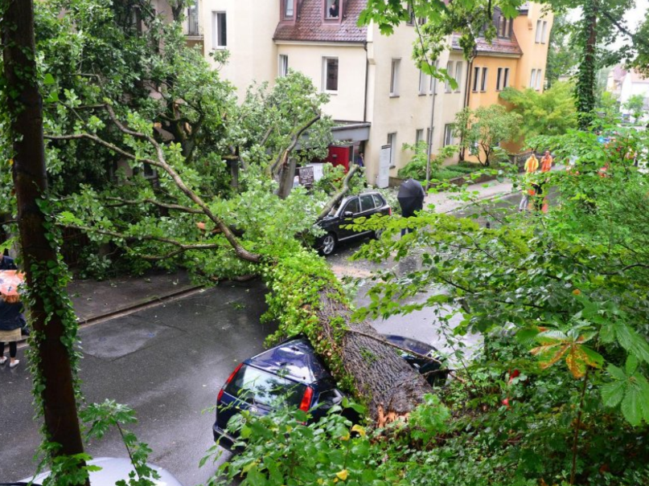
Company Profile
Why Tree Failure?
Forseeability?
Forensic Expert Witnesses

Slide 8
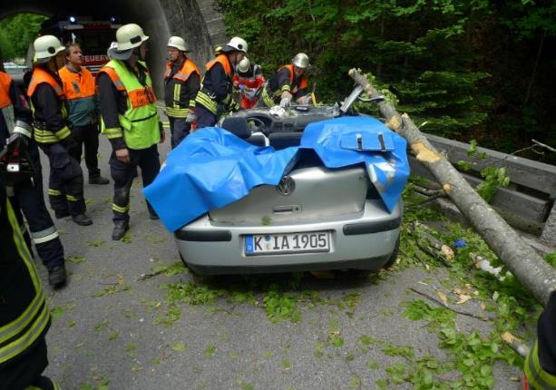
Company Profile
Why Tree Failure?
Forseeability?
Forensic Expert Witnesses

Slide 9
Wind Velocity in the Boundary Layer
α = 0,4
α = 0,28
α = 0,20
α = 0,16
Wind speed
Gustiness
Wind Loading

Slide 10
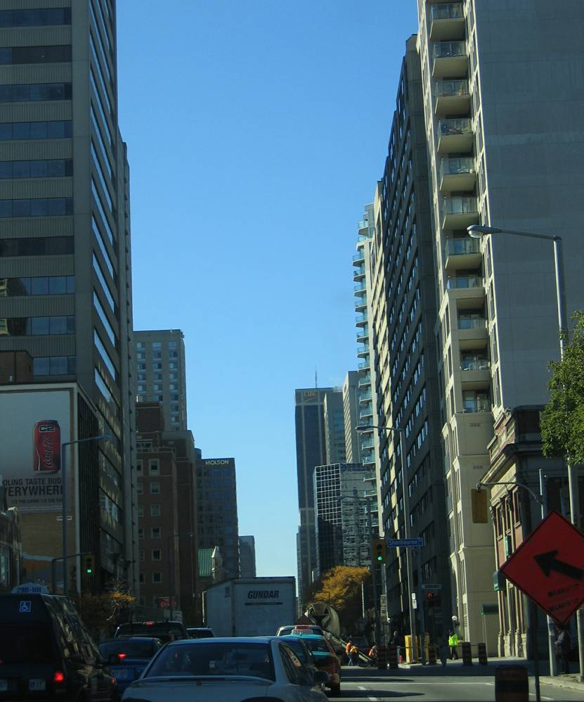
Gustiness in Urban Areas
Blow pipe effects
Ulmus americana Calgary, Al, CDN
Wind Effects in urban Areas
Wind Loading
Notes:
10

Slide 11
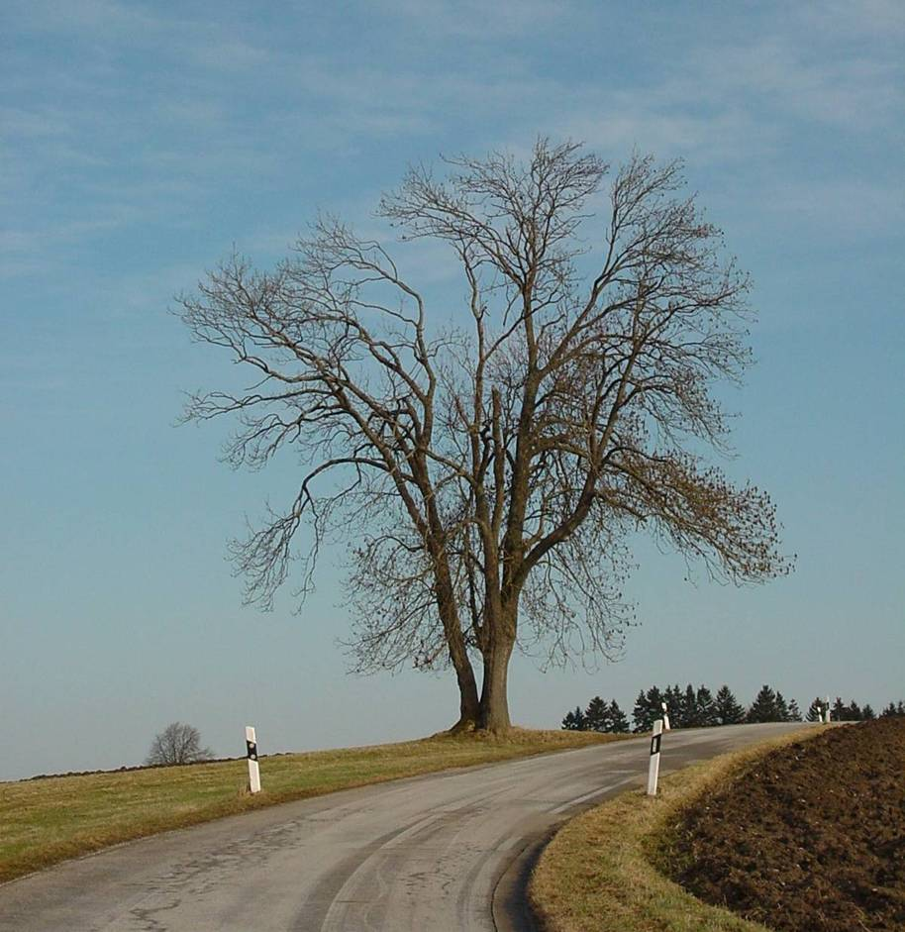
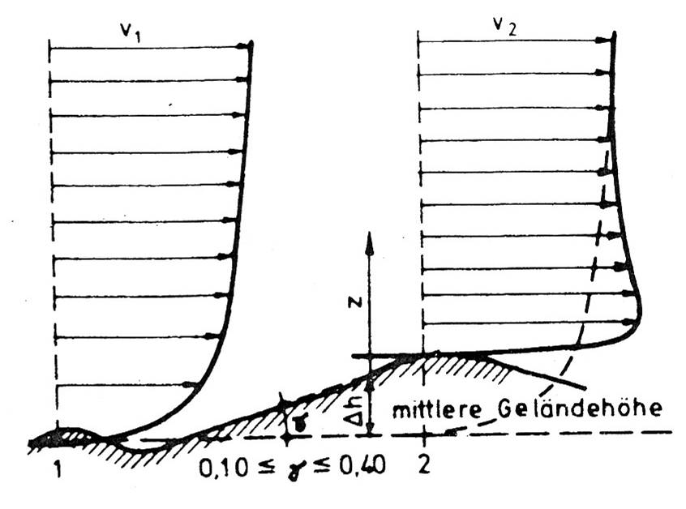
Topography
Crests of hills are obstacles in the wind flow.
In the luv and on top of hills wind velocities are increased.
Wind Loading
Notes:
11

Slide 12
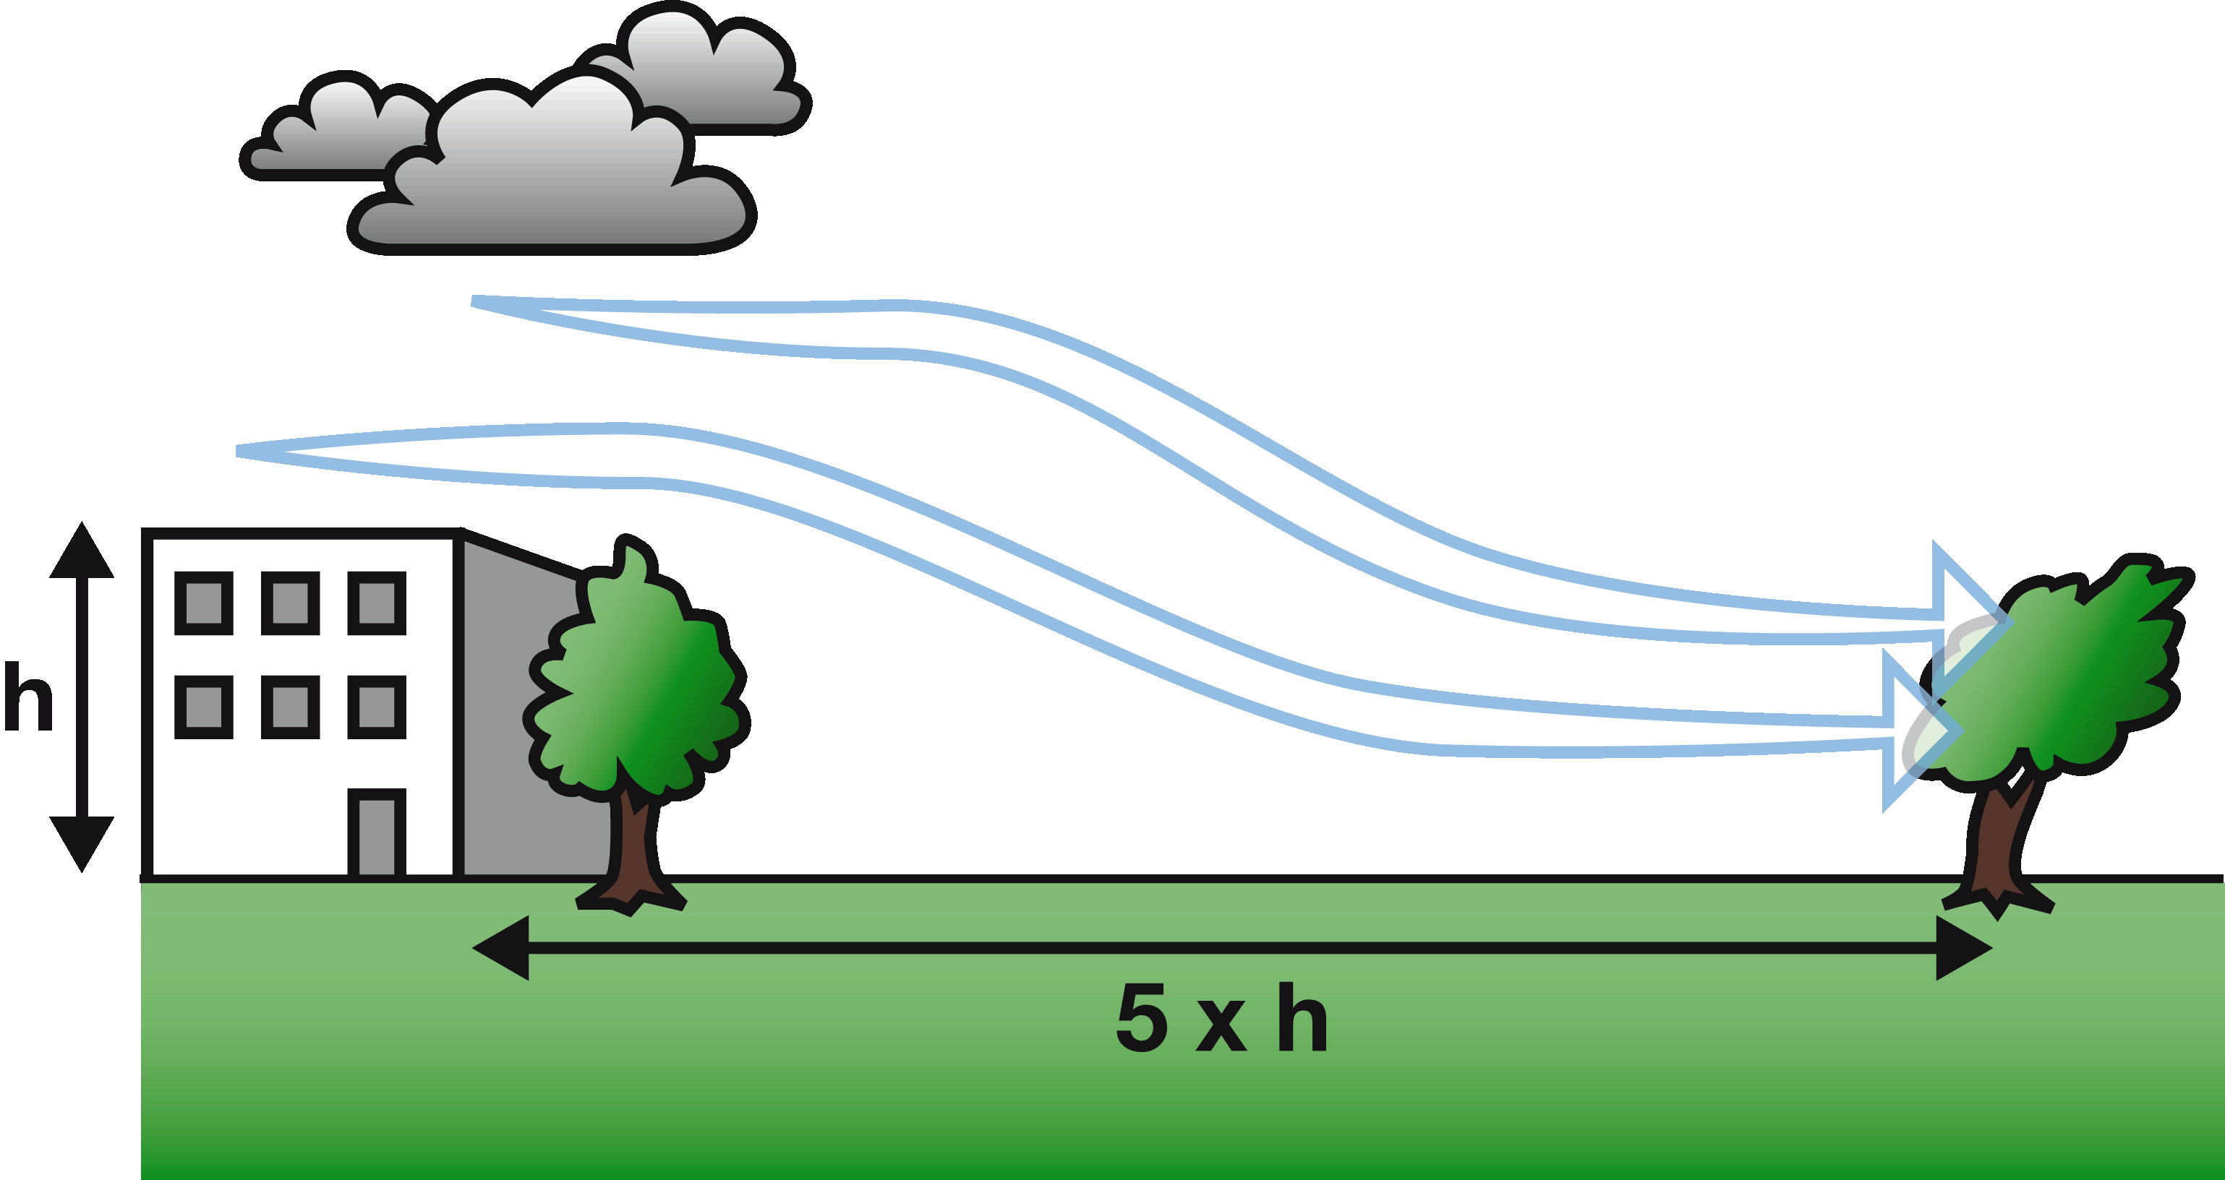
Protection from neighbouring Large Scale structures
Wind Loading

Slide 13
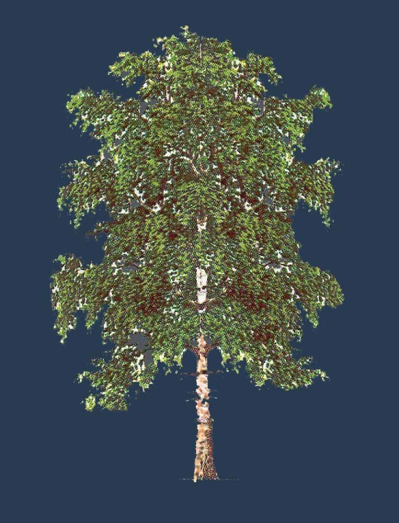
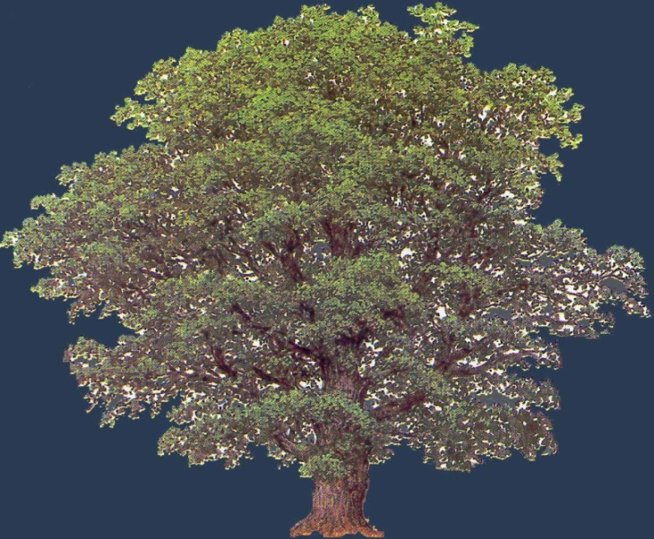
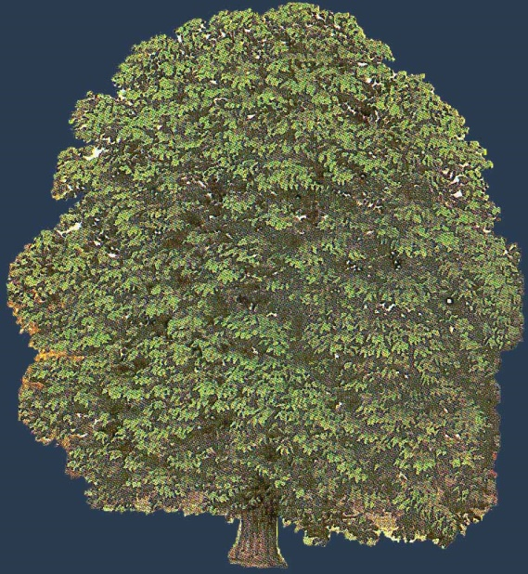
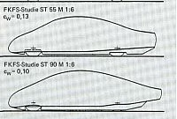
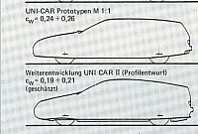
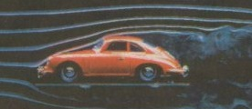
Crown reaction during storm gusts
Birch
Oak
Horsechestnut
0.12
0.25
0.35
Wind Loading

Slide 14
Stuttgart Strength Tables
kN/cm²
longitudinal
radial
tangential
Material Properties of Green Wood

Slide 15
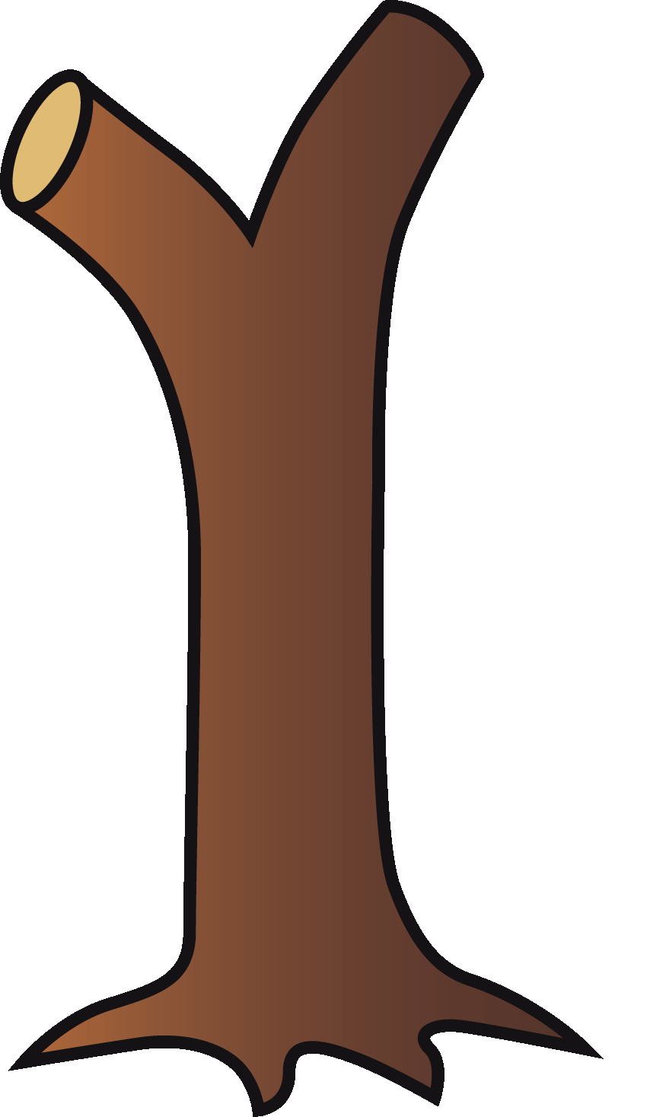
Limit of Elasticity in Beech
strength kN/cm²
# 156, Beech
85 years old
elastic limit in %
MOE
4.40 1610 0,273
3.60 1400 0,257
1.94 700 0,277
prop. limit in %
average 0.26
standard deviation 0.02
2.52 950 0,265
Material Properties of Green Wood

Slide 16
Steady State Balance
M_{res bend}= D³ x Π/32
Growth
0,5 cm
Decay 30 cm
Diameter 100 cm
Load bearing Geometry

Slide 17
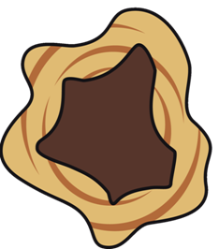
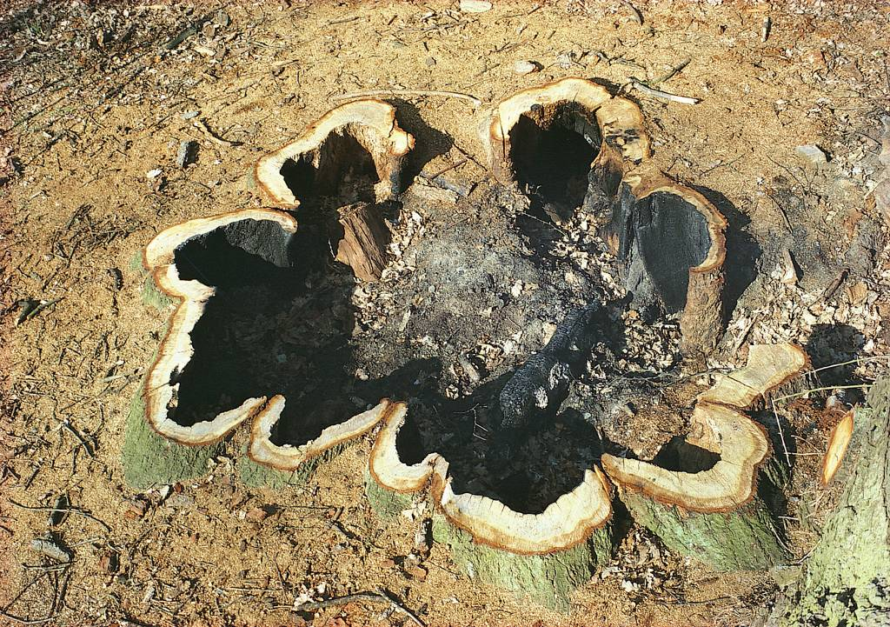
Relevance of Hollow Cylinders
load
peak stress levels
occur in a stem‘s marginal fibres
neutral axis
neutral axis
Load bearing Geometry
Notes:
17

Slide 18
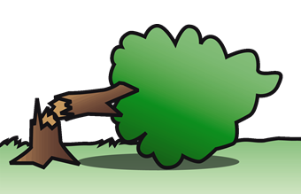
Modes of Failure
Breaking failure
Uprooting failure
Failure of root soil matrix
Stem / Limbs/Branches
TreeCalc is designed to evaluate Breaking Failure only

Slide 19
ArboSafe GmbH
Desktop Software for Pulling Test Evaluation, including wind load analysis, EN 1991/4-1
Desktop Software for Tree Appraisal, Calculating Root Loss Area
Online Software for Tree Safety Analysis,
Calculating Stem Breaking Resistance
Software Forge for Tree Safety Analytics
Notes:
Good afternoon. Arbosafe is a software forge in a small niche of the niche market tree consultancy.
Since 2007 we create software for tree safety analytics.
In 2007 we developped arbostat software that is designed to evaluate data obtained from tree pulling tests. Arbostat speaks German and English.
Root Calc was out next much small project. It is used mainly for tree appraisal and allows for calculating root loss areas.
And finally in 2013 we developped TreeCalc an pay-as you-use online software which is mz today’ s topic.

Slide 20
What is TreeCalc?
Online Software to evaluate the breaking safety of tree stems
Why using TreeCalc?
Systematic and methodologically correct evaluation of the
breaking safety of tree stems
On site tree safety assessment
Favourably verified in combination with stem tomography
TreeCalc recognizes good Practice of Statics

Slide 21
Who is using TreeCalc?
More than 850 users world wide
Consultants
Arborists
Public sector environmental officers
Scientists
TreeCalc recognizes good Practice of Statics

Slide 22
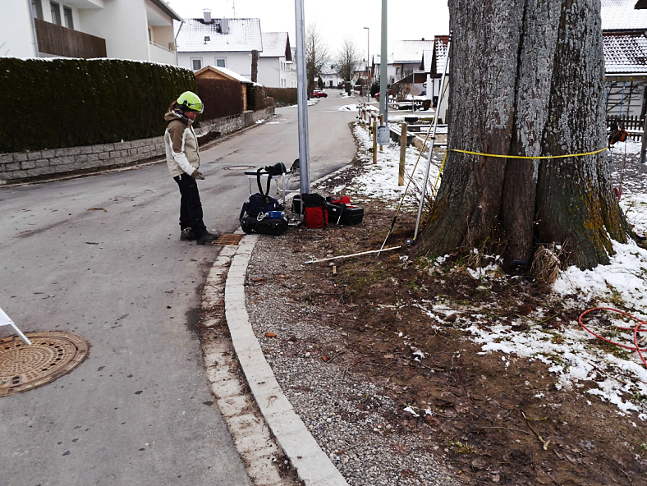
Initial situation: the „Sin“
Excavation in 600 mm distance from tree stem
Arising questions:
How many roots severed?
Diameter of roots affected?
Distance from stem?
0,6m
Resistance against Uprooting is questionable

Slide 23
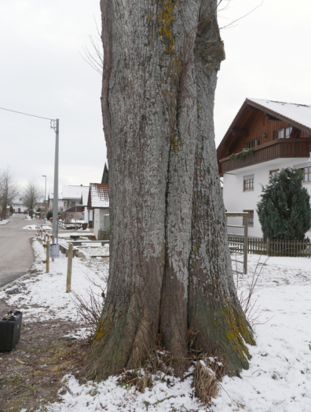
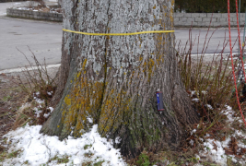
Symptoms of Reduced Safety
Recessions in the stem
Large growth deficits on the stem
DBH₁ = 146, DBH₂ = 110 [cm]
Resistance against Fracture of Stem

Slide 24
Symptoms of Reduced Safety
Ability of compensation
Increase of the root flare diameter results in disproportionately increased breaking safety
Bending resistance moment= D³x π/32
146/110cm=1,33; 1,33³ = 2,34
110cm
Factor 2,3
146cm
Resistance against Fracture of Stem

Slide 25
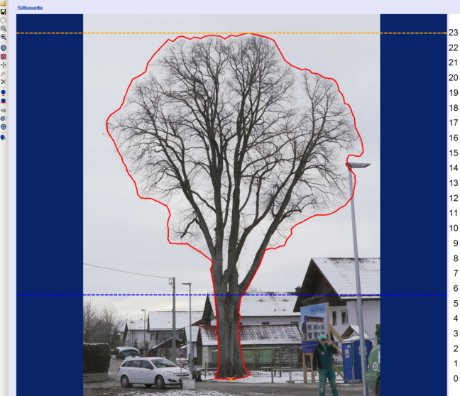
Pulling Test Method
Factors for Windload analysis
Wind speed: 32,5m/s
Air temperature: 0° C
Height above sea level: 740 m
Terrain roughness: EN1991: Cat. 3
Crown reaction: C_{w} 0,25
Exposure: low
18,3 kN
Properties of green wood:
15,4m
Young´s modulus : 8500 MPa
Comp. strength: 20 MPa
Limit of proportionality: 0,24%
Geometry of the stem:
Stem diameter: DBH = 146/110 [cm]
Small leaf Linden, H= 23 m
Gale Moment: M_{b} = G x c_{w} x ρ/2 x ∑ [ h(z) x A(hz) x v(z)²
Evaluation of Tree Safety

Slide 26
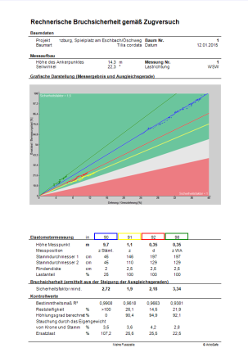
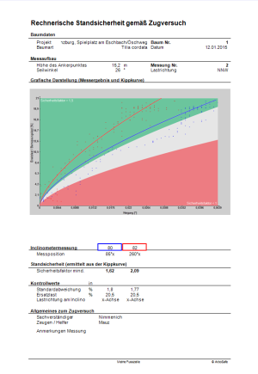
Results: Factor of Safety of Stem and Root-Soil Compound
Basic Safety 5,0
1,9
1,6
Results of Pulling Test Measurements with ArboStat

Slide 27
There is a much easier way!
www.treecalc.com
Online Calculation of breaking Safety of the Stem

Slide 28
TreeCalc does it all
Windows
Linux
MAC
iPAD iPHONE iPOD
Blackberry
Android
Versatility

Slide 29
Access: www.treecalc.com
Browser based Online Software

Slide 30
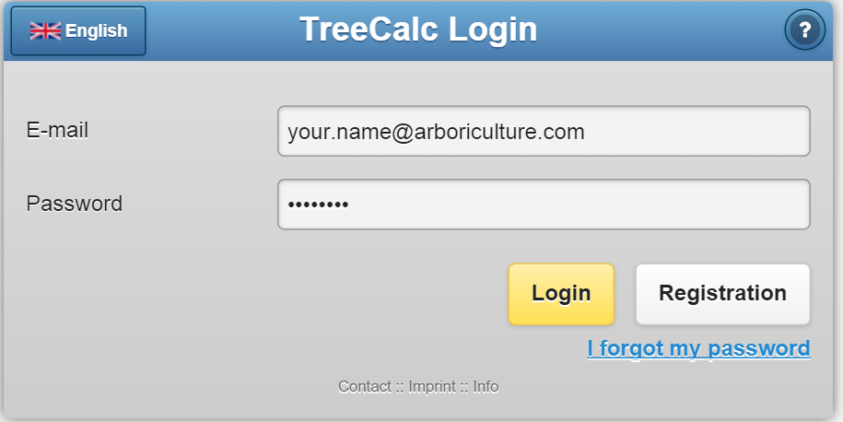
Login
Free Code EZEVL4 / I49JLK (8.3.19)

Slide 31
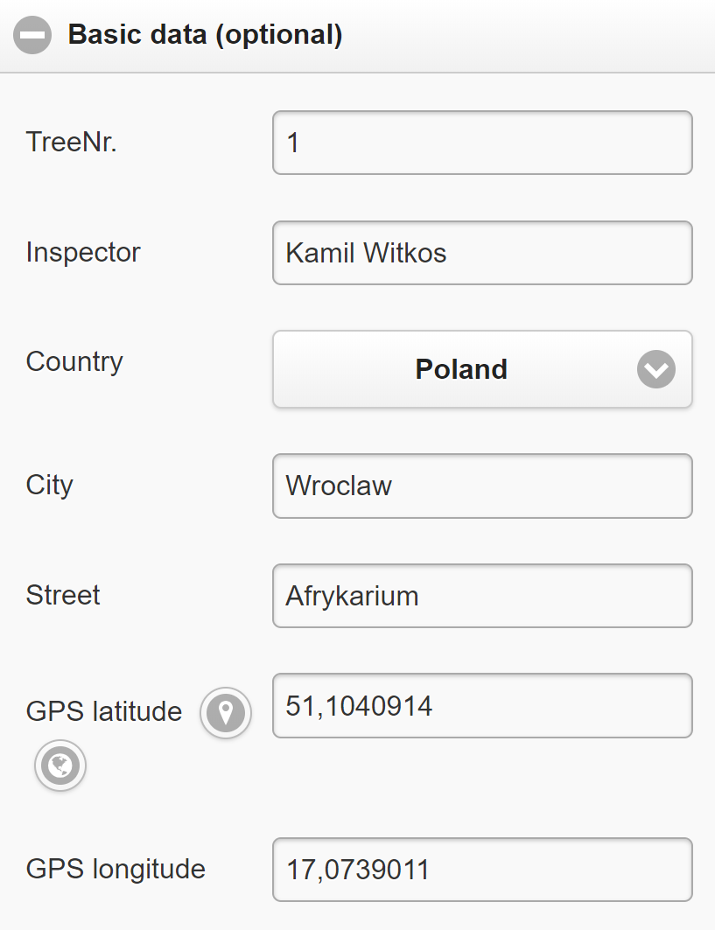
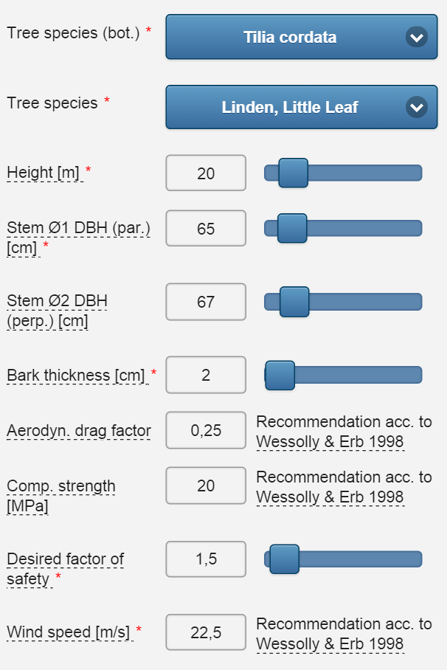
Data Entry:
Basic Data

Slide 32
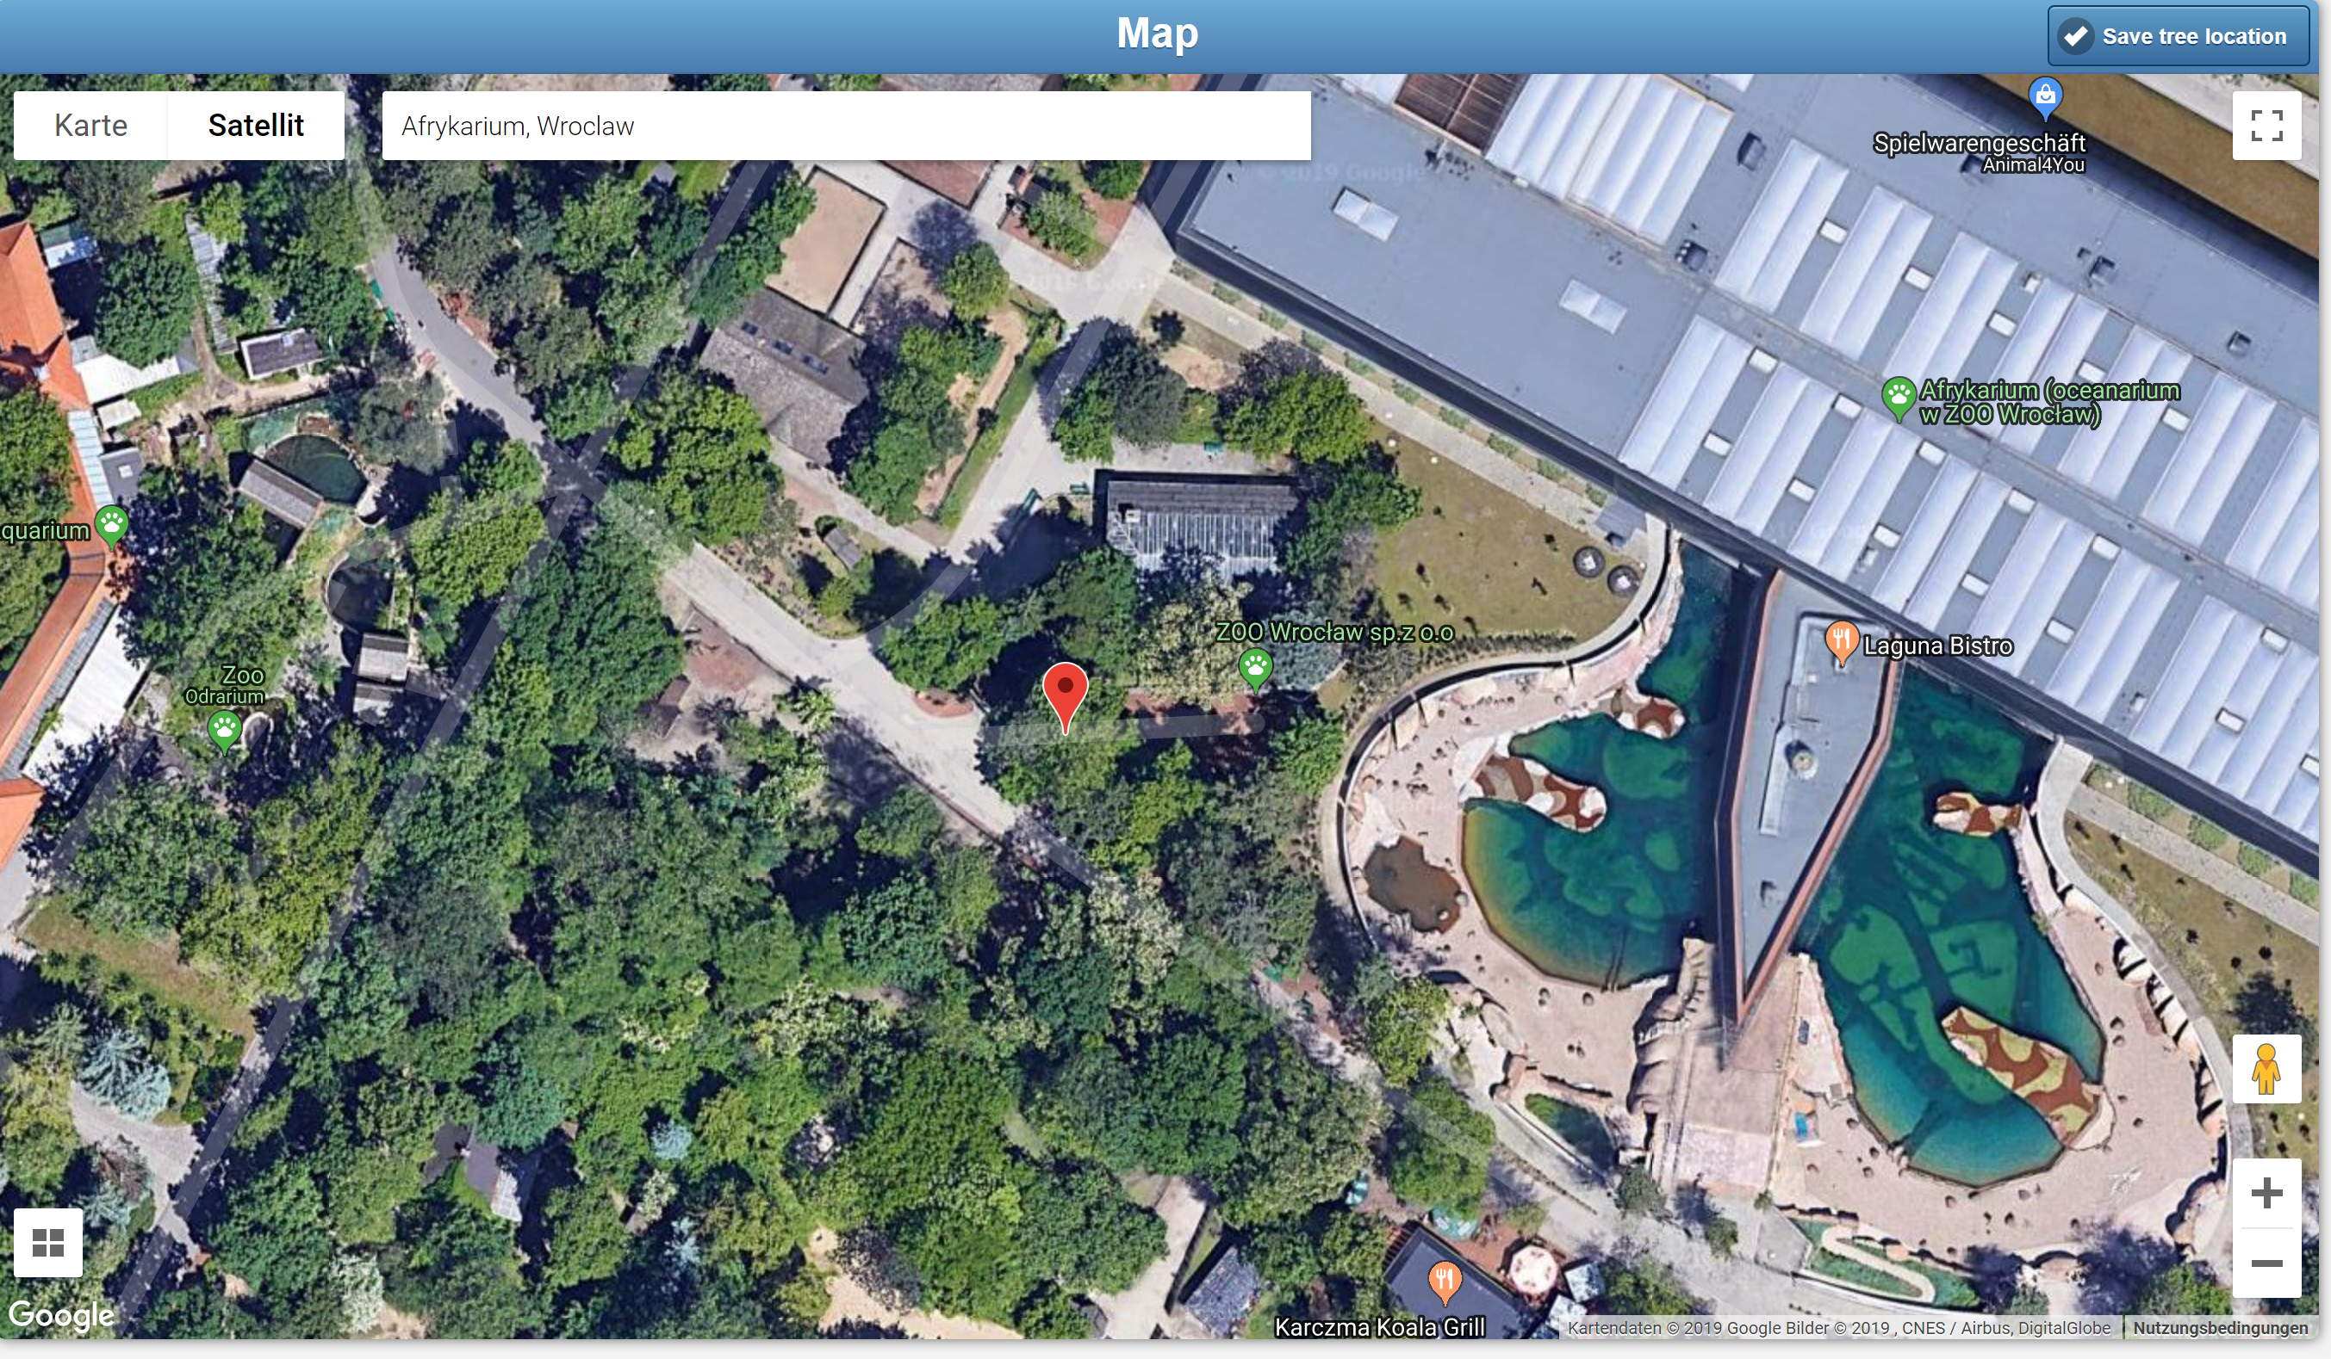
Data Entry:
Display Geo Position of desired Tree

Slide 33
Data Entry:
Species related data
Basic Data

Slide 34
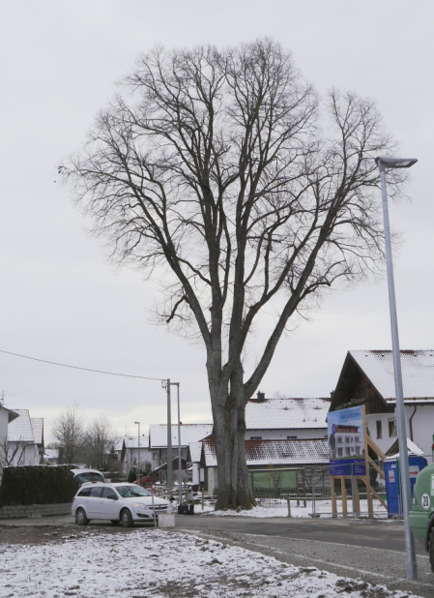
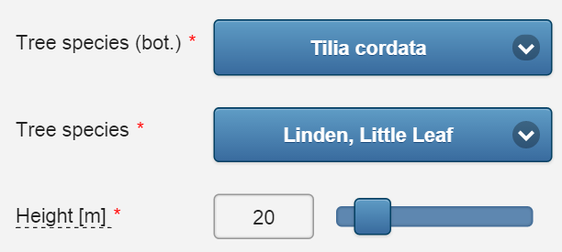
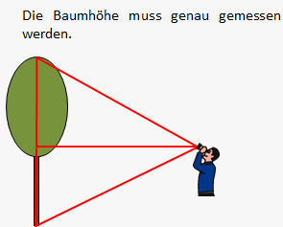
Data Entry
Tree height needs to be measured acurately
Tree Species and Tree Height

Slide 35
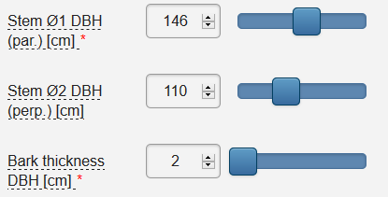
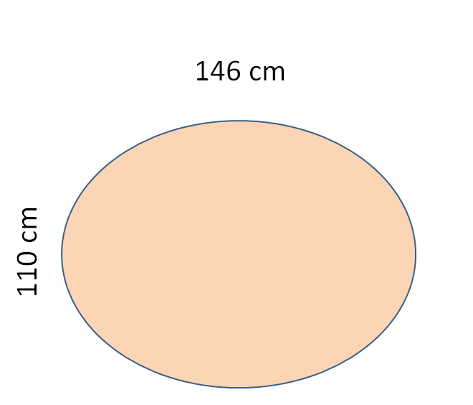
Data Entry
146 cm
110 cm
Stem Geometry

Slide 36
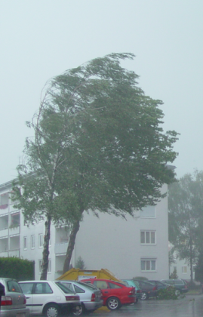
Data Entry
The wind resistance of tree crowns can either be obtained from a lookup table or be entered individually.
Drag Coefficient of Tree Crown

Slide 37
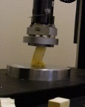
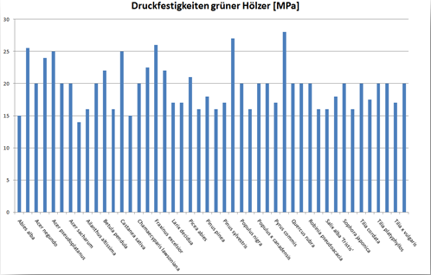
Data Entry
Published data of material proper-ties of green wood can be picked from lookup tables.
Individual values can be entered.
Compr. strength of green wood [MPa]
Compressive Strength of Green Wood

Slide 38
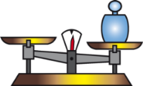
Data Entry
500 kNm
Capacity
250 kNm
Wind Load
Tree
Wind load
Stem diameter
Wood strength
Anchorage of roots
Structural Deficits
Location
Tree height
Wind resistance
Crown area
Dampening effects
Factor of safety 2
Expression of how much stronger a tree is than it needs to be for an intended load
Factor of Safety

Slide 39
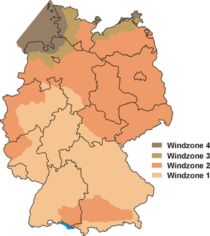
Data Entry
Wind zones acc. to EN 1991-1-4
Wind zone | Wind speed | Wind pressure
 | (m/s) | (kN/m²)
1 | 22,5 | 0,32
2 | 25 | 0,39
3 | 27,5 | 0,47
4 | 30 | 0,56
For each European country individual norms apply.
e.g. Germany has 4 zones
Wind Speed

Slide 40
Data Entry
10 Basic Crown Shape Patterns

Slide 41
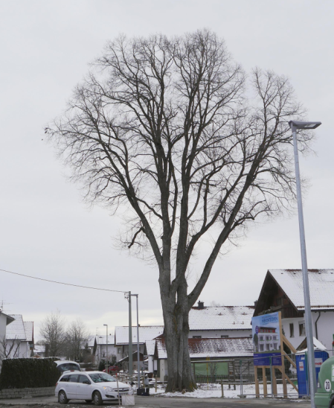
Data Entry
The Crown shape can be either adjusted with a ruler or by swiping.
To avoid accidental adaption on a small screen the shape can be locked.
Adapting Basic Tree Crown Patterns

Slide 42
Data Entry
Wind pressure
The wind pressure is influended by wind speed and the mass of the air.
The roughness of the terrain´s surface influences the wind speed in the boundary layer.
Trees are often better wind protected in urban settings with multi story buildings.
Surface Roughness

Slide 43
Calculate Button
Cost: 1 Calc
1,85-2,49 €
8-10,7 Zł
Running a Calculation

Slide 44
Results
Basic Safety
Factor of Safety
Required residual wall
Influence of cavities
on stem breaking safety
Basic Safety, Residual Wall, Magnitude of Decay Extent

Slide 45
Results
0,85
Explanations

Slide 46
Results
Various stem cross-sections
Adaption to relevant load direction
Adaption of the opening
Basic safety = colour coded
Legend: > 0
1><1,5
<= 1,5
Stem Geometry

Slide 47
Results
Different load bearing capacities of varying cross-sections can be compared to stem tomography and evaluated
Stem Geometry

Slide 48
Results
A new function enables assessment of weak zones in upper regions of tree stems
Shift Height of Damage on Tree Stems

Slide 49
Results
Shifting height of cross section level
Different load bearing capacities of varying cross-sections can be compared to tomography and evaluated
Shift Height of Damage on Tree Stems

Slide 50
Results
Crown Reduction
In case the desired safety margins are not sufficient a crown reduction is being proposed.
Whether a crown reduction is feasible has to be revised.
Statements referring to the magnitude of a crown
reduction are given in meters of tree height or in percent according to German norms.
Recommendations

Slide 51
Reports
Overview of all parameters used
Tree position in map
Results and pics of stem diameter (Tomography)
Report Print Outs

Slide 52
Reports
Evaluation of the influence of cavities in the upper stem on the tree´s breaking resistance.
Suggestion for crown reduction if the safety factor is below threshold.
Comments can be enterd as well as signature and company stamp
Report Print Outs

Slide 53
Examples
Oak at Ashton Court, UK

Slide 54
Examples
Scott´s Pine at Feldafing

Slide 55
Examples
0,5 m
8,0 m
Damage in different Heights above Ground

Slide 56
Backend
Purchasing „Calcs“
History of payment method
History of payments
My Account

Slide 57
Backend
History

Slide 58
Backend
Report Settings

Slide 59
Pros over previous versions:
Access at any time at any location with internet access
No software maintenance (e.g. update installation, data backup)
No extra cost for software updates
Fair cost for a „second opinion“
Users trying out different calculations, pay 10-20 € per tree including report
https://treecalc.com

Slide 60
Pros over previous versions:
Written documentation as pdf reports
All data are being stored in a database and can be exported for further use
https://treecalc.com

Slide 61
Pros over Cost free SIA Versions:
More crown shapes
Modification of the crown shape
More material properties of different species
Selection of more cross sections
More acurate crown reduction recommendations
All parameters can be modified individually
Shifting height of compromised zone at stem
More transparency, all parameters are presented more comprehensible
https://treecalc.com

Slide 62
Cons against previous versions:
Pay as you use
https://treecalc.com

Slide 63
Troubleshooting
Android: disable add blocker software in Firefox.
Rough ruler movement often is slow and unprecise using
Firefox and Android browsers (fastest browser is Chrome)
https://treecalc.com

Slide 64
Thank You for Your Attention
https://treecalc.com

